Slide 1
Bob Corker
From Wikipedia, the free encyclopedia
https://en.wikipedia.org/wiki/Bob%20Corker
Licensed under CC BY-SA 3.0:
https://en.wikipedia.org/wiki/Wikipedia:Text_of_Creative_Commons_Attribution-ShareAlike_3.0_Unported_License

Slide 2
Bob Corker
In 1978, Corker founded a construction company, which he sold in 1990.
Corker announced his candidacy for the 2006 U.S. Senate election in Tennessee after Frist announced his retirement.
On September 26, 2017, Corker announced that he would not seek reelection in 2018; Republican U.S. Representative Marsha Blackburn was elected to succeed him.

Slide 3
Early life and family
Corker was born in Orangeburg, South Carolina, the son of Jean J.
(née Hutto) and Robert Phillips "Phil" Corker.
Congressman Stephen A. Corker.
Corker graduated from Chattanooga High School in 1970 and earned a Bachelor of Science degree in Industrial Management from the University of Tennessee in Knoxville in 1974.
Corker is a member of Sigma Chi fraternity.
Corker and his wife Elizabeth, whom he married on January 10, 1987, have two daughters.

Slide 4
Business career
In an interview with Esquire, Corker said that he started working when he was 13, collecting trash and bagging ice.
The construction company became successful, growing at 80 percent per year, according to Corker, and by the mid-1980s carried out projects in 18 states.
As of 2008, Corker's assets were estimated at more than $19 million.

Slide 5
1994 Senate campaign
Corker first ran for the United States Senate in 1994, finishing second in the Republican primary to eventual winner Bill Frist.
During the primary campaign, Frist's campaign manager attacked Corker, calling him "pond scum".
From 1995 to 1996, Corker was the Commissioner of Finance and Administration for the State of Tennessee, an appointed position, working for Governor Don Sundquist.

Slide 6
Mayor of Chattanooga
Corker served as mayor of Chattanooga from 2001–05.
The program has been continued by Corker's successor, Ron Littlefield.
Corker has credited the increased collaboration between departments for decreasing crime in Chattanooga.
Corker was also heavily involved in the redevelopment of the Enterprise South Industrial Park in Chattanooga, the site of the former Volunteer Army Ammunition Plant.

Slide 7
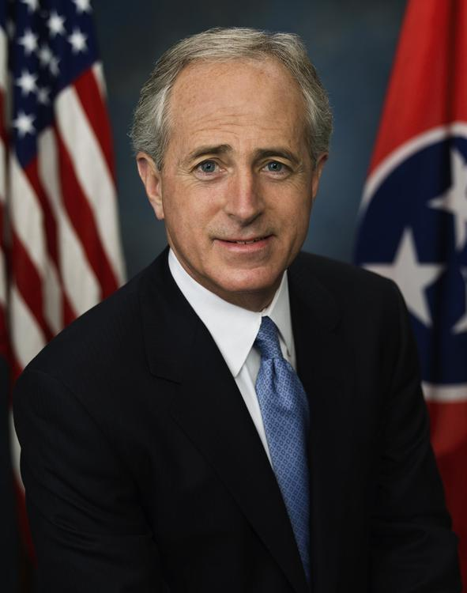
Corker Senate portrait (2007)

Slide 8
Elections
In 2004, Corker announced that he would seek the U.S. Senate seat to be vacated by incumbent Republican Senator Bill Frist, who had announced that he would not run for reelection.
Corker denounced the ad and asked that it be taken off the air.
Corker won the election by less than three percentage points.
Corker was sworn in as Senator on January 4, 2007.
In November 2012, Corker won his re-election bid with 65% of the vote.

Slide 9
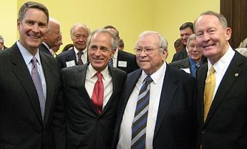
Corker was joined at his inauguration by Bill Frist, Howard Baker, and Lamar Alexander

Slide 10
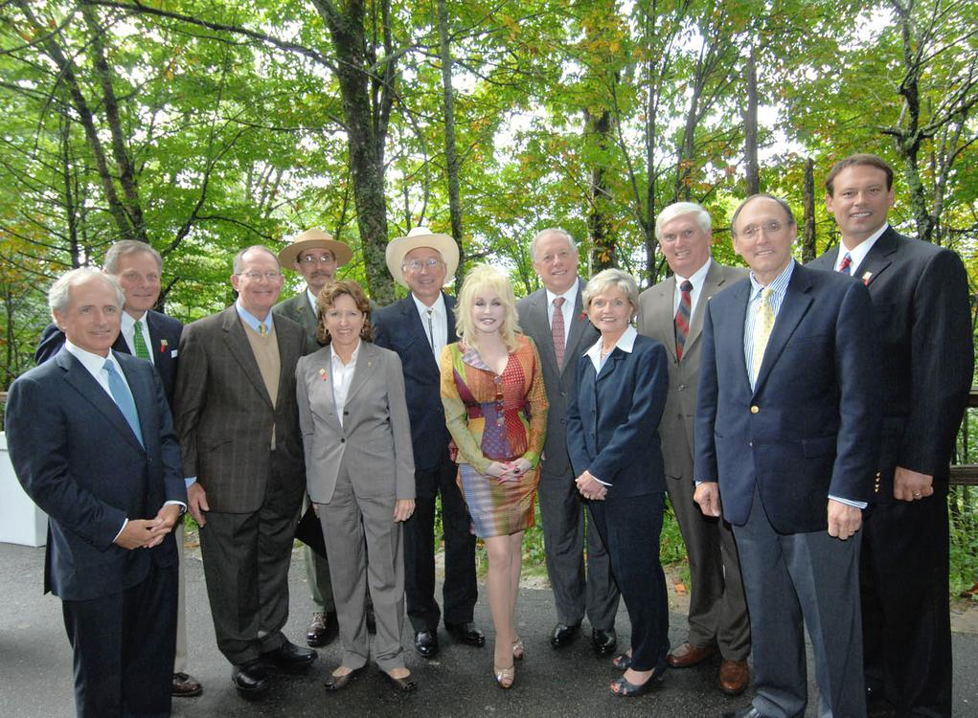
Senators Bob Corker, Richard Burr, Lamar Alexander, Congressman John Duncan, and Dolly Parton among others at the Great Smoky Mountains National Park in 2009

Slide 11
Tenure
Amendments by Corker and fellow Republican John Kyl on missile defense and modernization were among the few accepted.
Corker was one of thirteen Republican senators to vote for the final version.
Corker voted with 40 Republicans and 5 Democrats to stop the passage of the bill.
In August 2018, Corker and Bob Menendez signed a letter warning that Congress would refuse attempts by the Trump administration to form congressional appropriations for foreign aid.

Slide 12
Committee assignments
Committee on Banking, Housing, and Urban Affairs
Subcommittee on Housing, Transportation, and Community Development
Subcommittee on Securities, Insurance and Investment
Subcommittee on Financial Institutions and Consumer Protection
Committee on Foreign Relations (Chairman)
Subcommittee on African Affairs (Ex Officio)
Subcommittee on European Affairs (Ex Officio)
Subcommittee on East Asian and Pacific Affairs (Ex Officio)
Subcommittee on Near Eastern and South and Central Asian Affairs (Ex Officio)
Subcommittee on Western Hemisphere and Global Narcotics Affairs (Ex Officio)
Subcommittee on International Development and Foreign Assistance, Economic Affairs, and International Environmental Protection (Ex Officio)
Subcommittee on International Operations and Organizations, Human Rights, Democracyand Global Women's Issues (Ex Officio)

Slide 13
Retirement
On September 26, 2017, Corker announced that he would not seek re-election in 2018, keeping his pledge when he ran in 2006 to only serve two terms in the Senate.
However, Corker refused to use his powers as Senate Foreign Relations chairman to use procedural leverage in the Senate to influence Trump's rhetoric and actions.

Slide 14
Political positions
Bob Corker is considered a moderate conservative and is often labelled as a moderate rather than a conservative.
Corker scored 80% on American Conservative Union's 2017 Ratings of Congress.

Slide 15
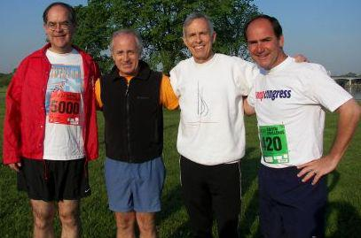
Corker with U.S.

Slide 16
Social policy
In the 2006 primary campaign, Corker's opponents claimed he had changed his view on abortion since his first Senate campaign in 1994.
Corker has since changed his position and opposes abortion on demand except when the life of the mother is endangered or in cases of rape or incest.
Corker opposes same-sex marriage.

Slide 17
Fiscal policy
In 2006, Corker supported making the 2001 tax cut and the 2003 tax cut permanent.
Corker referred to such programs as Medicare and Social Security as "generational theft".
In 2013, Corker endorsed the Marketplace Fairness Act and voted for its passage in the Senate.
Corker was the only Republican senator to vote against the Senate version of the Tax Cuts and Jobs Act of 2017 before it was sent to a conference committee with the House, citing concerns about the deficit.

Slide 18
Foreign policy
In May 2008, Corker and Democratic U.S.
I hope we dig a lot deeper," said Corker.
The claim was refuted by Corker's communications director and news outlets.
In 2017, Corker criticized President Trump's provocative tweets against North Korea as impulsive.
Corker's comments were not met with public dissent; Republicans appeared to agree with Corker.

Slide 19
Saudi Arabia
Corker received campaign donations from Saudi Arabia's lobbyists.
In late November 2018 in an initial procedural step, Senator Corker joined with others backing an effort to suspend U.S. support for the Saudi-led war in Yemen.
About the resolution, Corker stated it was a "strong denouncing of a crown prince and holding them responsible for the murder of a journalist", further considering it a "pretty strong statement for the United States Senate to be making, assuming we can get a vote on it."

Slide 20
Health care policy
In September 2009, Corker opposed a health-care reform amendment that would legally allow Americans to buy cheaper Canadian drugs.
Amid Republican efforts to repeal the ACA following the election of Trump, Corker said in July 2017 he would support a repeal bill in the Senate even if it did not include a replacement effort.

Slide 21
Trade
At a July 2018 hearing on tariff policy, Corker stated, "I'm very concerned about the president's trade policies and I think we all should be.
In September 2018, after President Trump announced tariffs on 200 billion worth of goods from China, Corker stated that the move was misrepresented and Americans would be paying for the tariffs.

Slide 22
Environment
While Corker has expressed skepticism regarding the degree to which humans contribute to global warming, in 2015 he supported a resolution expressing the sense of the Senate that climate change is real and that humans contribute to it.
Corker opposed John McCain's 2008 campaign proposal to suspend the 18-cents-per-gallon federal gasoline tax, calling it "pandering extraordinaire".

Slide 23
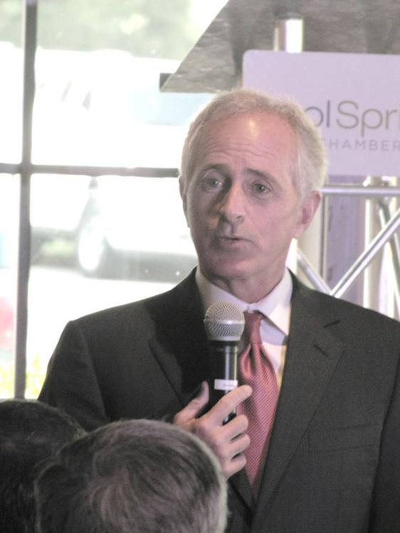
Corker speaking at the Brentwood Cool Springs Chamber of Commerce breakfast in 2010

Slide 24
Sale of protected wetlands
Public records show no involvement of Corker in the approval process.
The Corker campaign countered that an article published on March 5, 2003 in the Chattanooga Times Free Press publicly identified Corker's ownership interest in the land, through Osborne Enterprises, and that as mayor, a blind trust barred Corker from being involved in issues like these that affected his business.

Slide 25
Blind trust
Corker stated that the visibility of his properties and public knowledge of his ownership in them served as another check on his actions as mayor.
On October 11, 2006, The Commercial Appeal reported that the blind trust that Corker set up to run his businesses to avoid conflicts of interest while he was mayor "may not have been all that blind".
The e-mails show that Corker often met with officials from his private company, the Corker Group, which was part of the blind trust, while he was mayor.

Slide 26
Volkswagen
In 2014, Corker, a long-time opponent of unions in Tennessee, tried to influence the ballot election of blue-collar workers at the Chattanooga Volkswagen plant whether to allow the United Auto Workers to represent them.
Corker's public statement went counter to statements by Volkswagen officials in the lead-up to the vote that the outcome of the vote would not affect the determination of whether the SUV would be made in Chattanooga or at the Puebla, Mexico plant.

Slide 27
Further reading
"The tireless Tennessee dealmaker".

Slide 28
External links
Bob Corker at Curlie

